Slide 1
Algorithm in Python
Liz, VMware

Slide 2
Summary
Complexity Analysis
ADT
Stack, Queue, Heap
Sorting
Bubble, Insertion, Quick, Heap, Bucket
Search
Sequential,Binary, Hashing
Python tips

Slide 3
Complexity
Complexity including time and space complexity
Concerned about how fast or slow particular algorithm perform
Amount time depending on several factors
Processor, instruction set, disk, compiler and etc

Slide 4
Complexity
Big O notation
Informally, an algorithm can be said to exhibit a growth rate on the order of a mathematical function if beyond a certain input size n
Measure time T(n) as the number of elementary "steps" (defined in any way), provided each such step takes constant time
Steps to analyze the complexity of a algorithm
Line by line
Ignore
Notes:
大O符号（英语：Big O notation）是用于描述函数渐近行为的数学符号。更确切地说，它是用另一个（通常更简单的）函数来描述一个函数数量级的渐近上界。在计算机科学中，它在分析算法复杂性的方面非常有用。
大O符号通常用于表示某个算法在最差情况下的运行时间，但也可以用来表述平均情况的运行时间。比如，快速排序的最坏运行时间是 O(n^{2})，但是平均运行时间则是 O(n\log n)。
5.如果一个关于 n 的函数f(n)，乘以一个系数以后，能够为某个算法在输入数据大小n 足够大的情况下的运行时间提供一个上界，那么称此算法按该函数的阶增长。一个等价的描述是，当输入大小 n 大于某个 n 时，存在某个常数 c，使得算法的运行时间总小于 c\times f(n)。常用大O符号对此进行描述。
1. 计算出基本操作的执行次数T(n)
基本操作即算法中的每条语句（以;号作为分割），语句的执行次数也叫做语句的频度。在做算法分析时，一般默认为考虑最坏的情况。
2. 计算出T(n)的数量级
求T(n)的数量级，只要将T(n)进行如下一些操作：
忽略常量、低次幂和最高次幂的系数
令f(n)=T(n)的数量级。

Slide 5
Complexity
(1) int num1, num2;
(2) for(int i=0; i<n; i++){
(3) num1 += 1;
(4) for(int j=1; j<=n; j*=2){
(5) num2 += num1;
(6) }
(7) }
T(n) = 2 + 4n + 3n*log2n
f(n) = n*log2n
T(n) = O(n*log2n)
Notes:
语句int num1, num2;的频度为1；
语句i=0;的频度为1；
语句i<n; i++; num1+=1; j=1; 的频度为n；
语句j<=n; j*=2; num2+=num1;的频度为n*log2n；

Slide 6
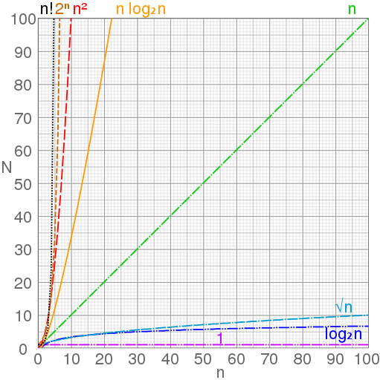
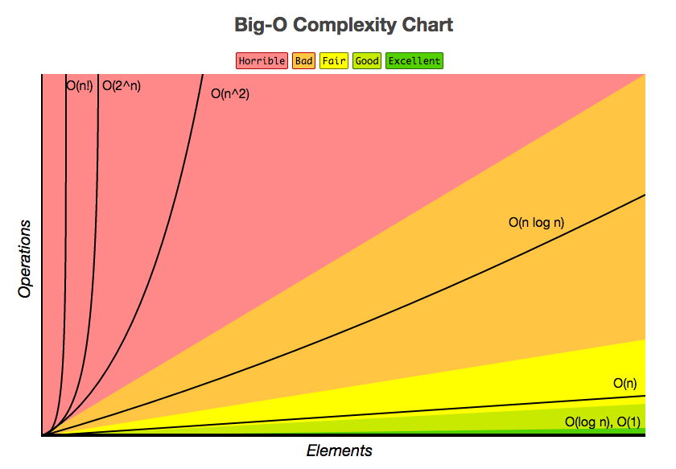
Complexity
Notes:
Ο(1)＜Ο(log2n)＜Ο(n)＜Ο(nlog2n)＜Ο(n2)＜Ο(n3)＜…＜Ο(2n)＜Ο(n!)

Slide 7
Abstract Data Type
Stack
Queue
Heap

Slide 8
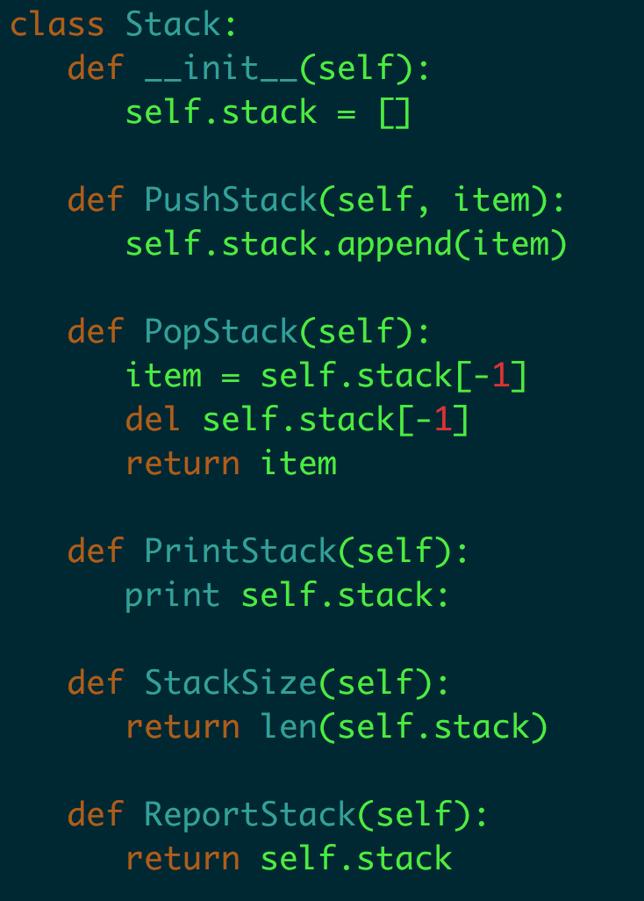
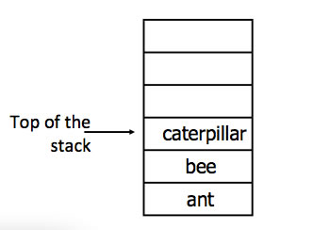
Stack FILO
Stack Operations:
Push
Pop
Print / Get
Stack size

Slide 9
Abstract Data Type
Stack
Queue
Heap

Slide 10
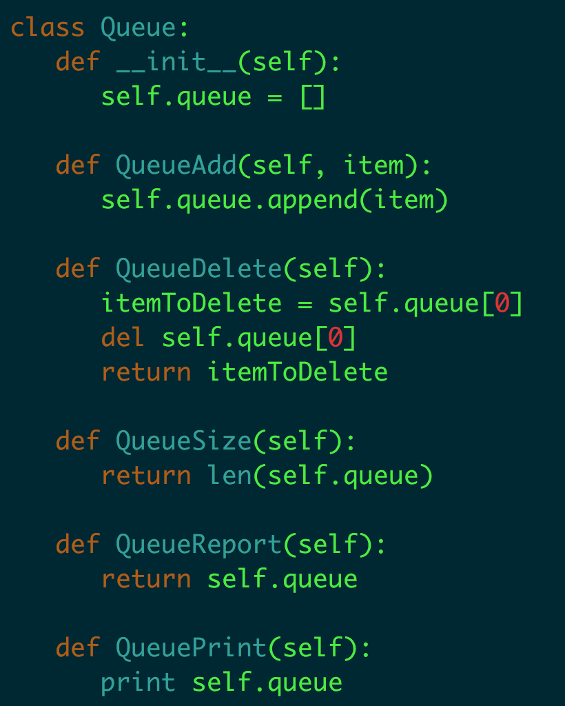
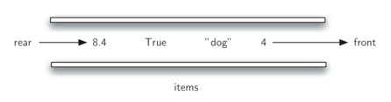
Queue FIFO
1. Add
2. Delete
3. Queue size
4. Print / Get

Slide 11
Abstract Data Type
Stack
Queue
Heap

Slide 12
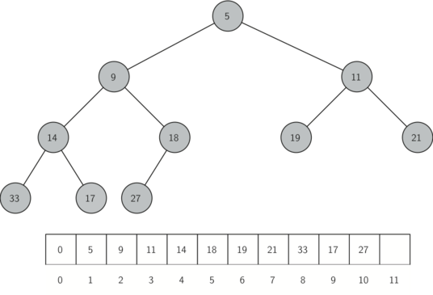
Heap
Specialized tree-based data structure
Max heap, Min heap
Implementation of a priority queue
Binary heap

Slide 13
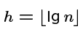
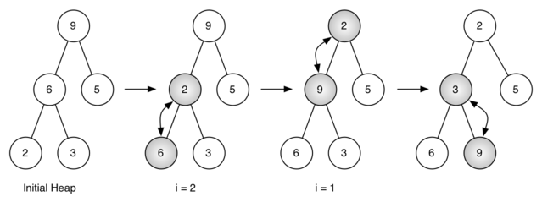
Heap (Build)
Insert new elements into the left-most open spot
The height h of an n element heap is bounded:

Slide 14
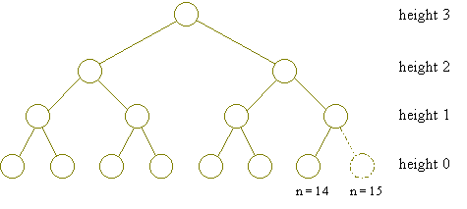
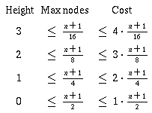
Heap (Build)

Slide 15
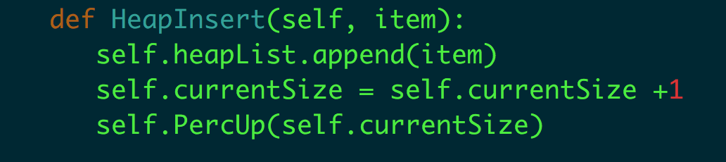
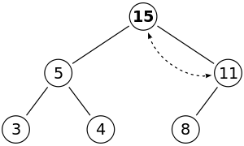
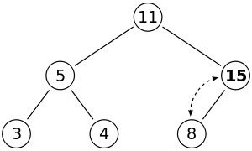
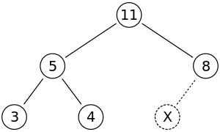
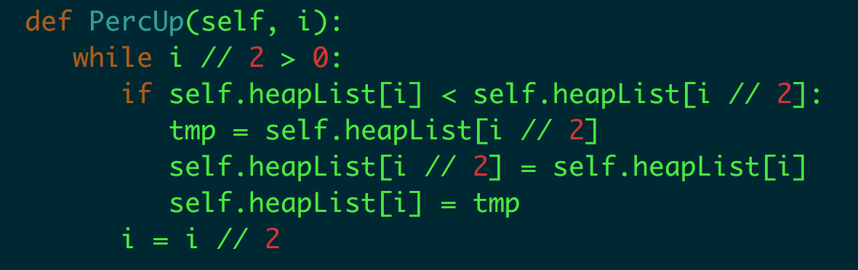
Heap Operation (Insert)
Insert

Slide 16
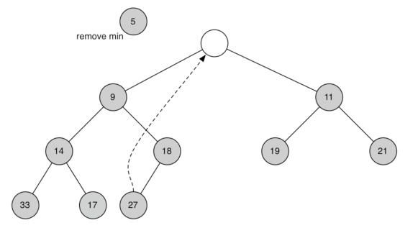
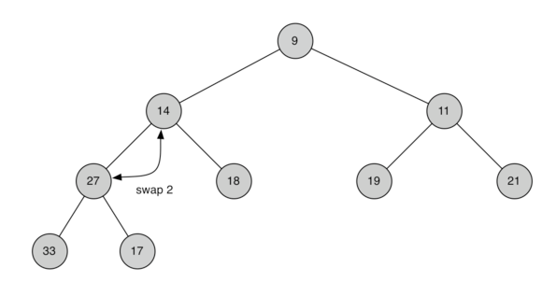
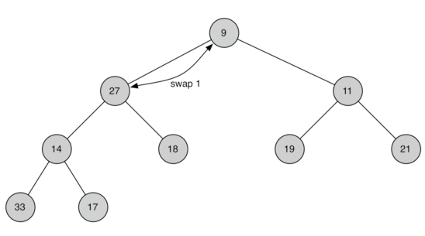
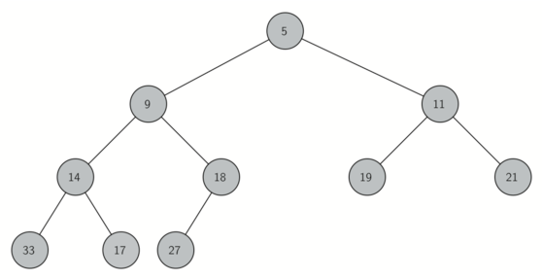
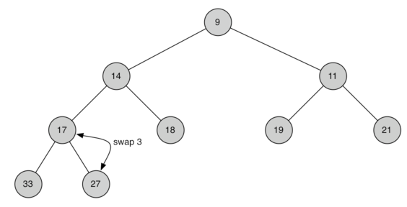
Heap Operation (Delete)

Slide 17
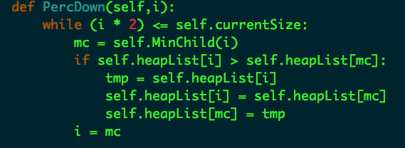
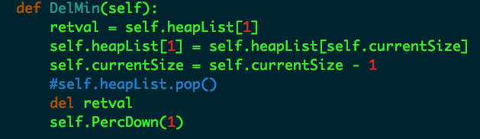
Heap Operation (Delete)

Slide 18
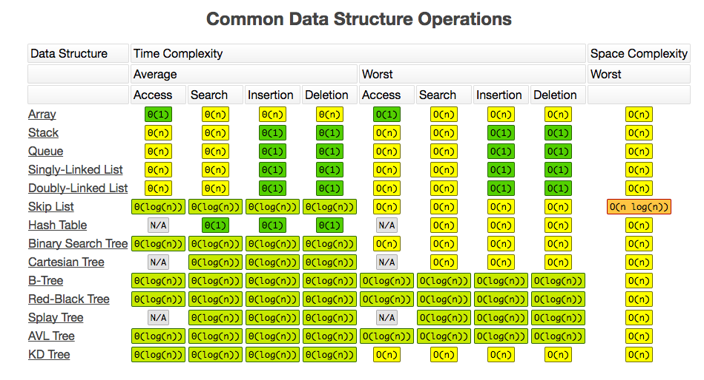

Slide 19
Sorting
Bubble Sort
Insertion Sort
Quicksort
Heap Sort
Bucket Sort

Slide 20
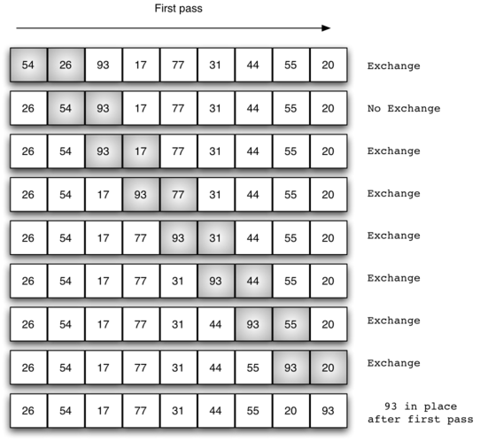
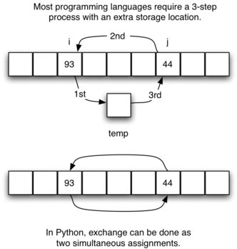
Bubble Sorting

Slide 21
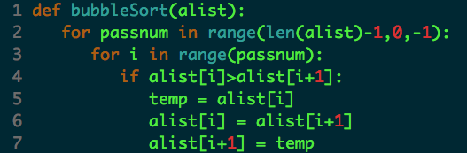
Bubble Sorting
Complexity Analysis

Slide 22
Sorting
Bubble Sort
Insertion Sort
Quicksort
Heap Sort
Bucket Sort

Slide 23
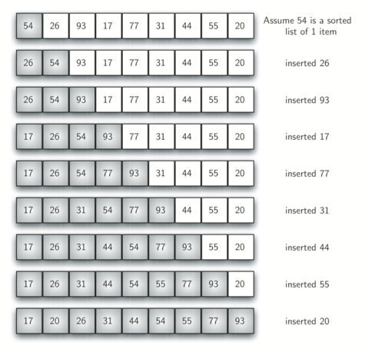
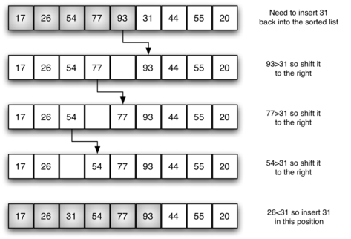
Insertion Sort

Slide 24
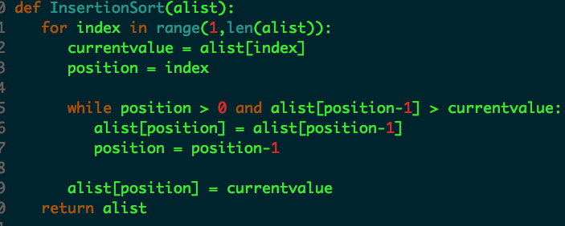
Insertion Sorting
Complexity Analysis

Slide 25
Sorting
Bubble Sort
Insertion Sort
Quick Sort
Heap Sort
Bucket Sort

Slide 26
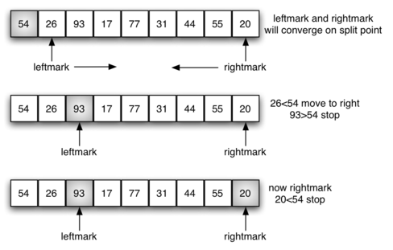
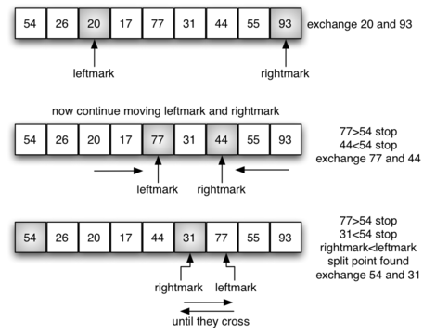
Quick Sorting

Slide 27
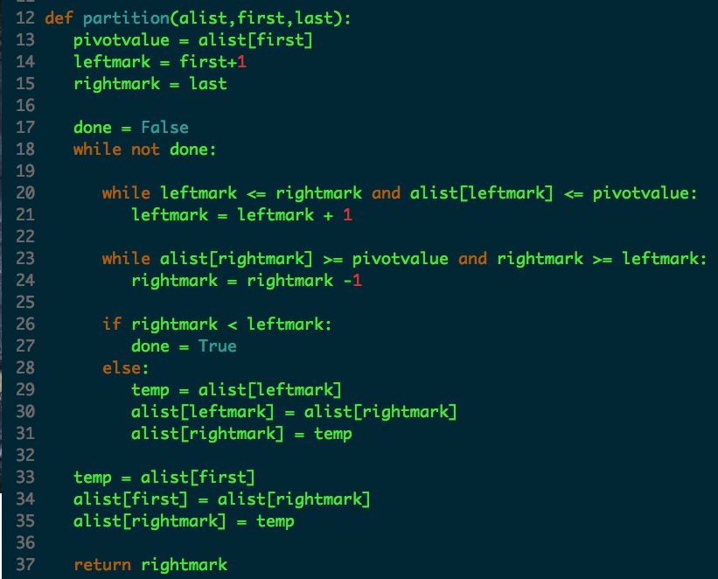
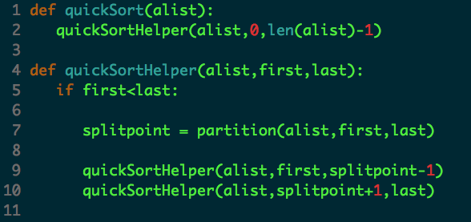
Quick Sorting
Complexity Analysis

Slide 28
Sorting
Bubble Sort
Insertion Sort
Quicksort
Heap Sort
Bucket Sort

Slide 29
Heap Sorting
Use only a single list as an internal representation
Min heap, max heap
Enqueue and dequeue iterms in O(log n)

Slide 30
Heap Sorting
Complexity Analysis

Slide 31
Sorting
Bubble Sort
Insertion Sort
Quicksort
Heap Sort
Bucket Sort

Slide 32
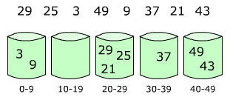
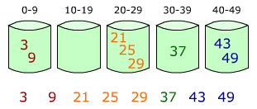
Bucket Sort
Set up an array of initially empty "buckets".
Scatter: Go over the original array, putting each object in its bucket.
Sort each non-empty bucket.
Gather: Visit the buckets in order and put all elements back into the original array.

Slide 33
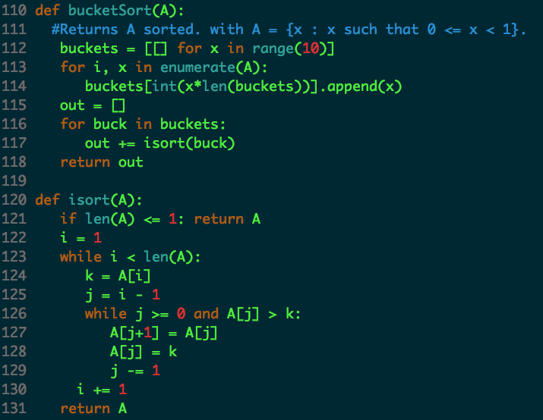
Bucket Sort
Complexity Analysis

Slide 34
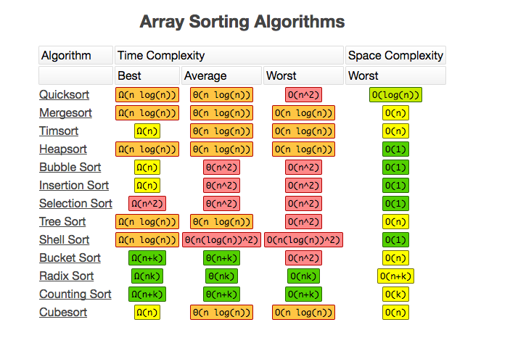

Slide 35
Search
Sequential Search
Binary Search
Hashing

Slide 36
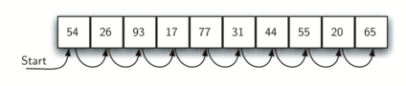
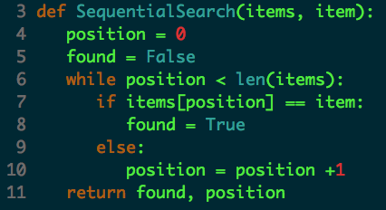
Sequential Search (Linear Search)

Slide 37
Search
Sequential Search
Binary Search
Hashing

Slide 38
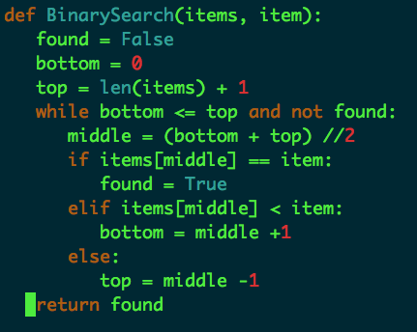
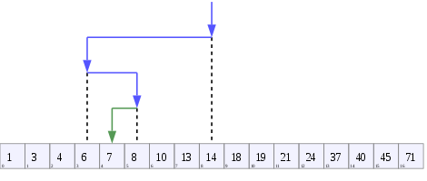
Binary Search
1,3, 4, 6, 7, 8, 10, 13, 14,
18, 19, 21, 24, 37, 40,45, 71

Slide 39
Search
Sequential Search
Binary Search
Hashing

Slide 40
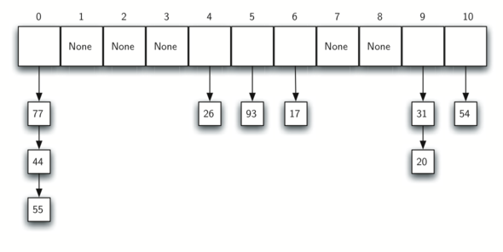
Hash
54, 26, 93, 17, 77, 31,44, 20, 55

Slide 41
Hashing
Given a collection of items, a hash function that maps each item into a unique slot
Perfect hash function
Increase the size of hash table
Notes:
Python dictionary is an example of a hash table

Slide 42
Python Tips
Shallow and deep copy
The difference between shallow and deep coping is only relevant for compound objects.
>>> colours1 = ["red", "green"]
>>> colours2 = colours1
>>> colours2 = ["rouge", "vert"]
>>> print colours1
['red', 'green']
>>> list1 = ['a','b','c','d']
>>> list2 = list1[:]
>>> list2[1] = 'x'
>>> print list2
['a', 'x', 'c', 'd']
>>> print list1
['a', 'b', 'c', 'd']
>>> colours1 = ["red", "green"]
>>> colours2 = colours1
>>> colours2[1] = "blue"
>>> colours1
['red', 'blue']

Slide 43
Python Tips (Work with String)
>>> a="codepython”
>>> a[4:]
'python'
>>> a[::-1]
'nohtypedoc’
>>> a = ["Code", "mentor", "Python", "Developer"]
" ".join(a)
>>> print "code"*4+' '+"mentor"*5
codecodecodecode mentormentormentormentormentor

Slide 44
The Difference Between py2 and py3
Print is a function in py3
Py3: print(“This is a print”)
Py2: print “This is a print”
Handling Exception
Py3: except NameError as err:
Py2: except NameError, err:
Integers
Py3: 5 // 2 = 2; 5 / 2 = 2.5
Py2: 5 // 2 = 2; 5 / 2 = 2

Slide 45
Python Tips
For-loop variables and the global namespace leak
i = 1
print('before: i =', i)
print('comprehension:', [i for i in range(5)])
print('after: i =', i)
Python 2.7.6
before: i = 1
comprehension: [0, 1, 2, 3, 4]
after: i = 4
Python 3.4.1
before: i = 1
comprehension: [0, 1, 2, 3, 4]
after: i = 1

Slide 46
Exercise
Find the Kth largest number

Slide 47
Solutions
1. Sort and search
Sort the given array using a O(nlogn) sorting algorithm
Time Complexity of this solution is O(nlogn)
2. Build a max heap with n nodes, and delete root k times
O(n + klogn)
3. Build a min heap has k nodes
O(k + (n-k)*logk)
4. QuickSort likely
The worst case time complexity of this method is O(n2), but it works in O(n) on average.
Only valid when numbers are
Notes:
Build a Max-Heap MH of the first k elements of the given array. O(k)
After the k’th element (arr[k] to arr[n-1]), compare it with root, if the element is less than the root then make it root and call ProcDown, else ignore
root of the MH is the kth smallest element
4. not to do complete quicksort, but stop at the point where pivot itself is k’th smallest element. Also, not to recur for both left and right sides of pivot, but recur for one of them according to the position of pivot.

Slide 48
Kth Largest number (quick sort)
QuickSelect(A, k)
# let r be chosen uniformly at random in the range 1 to length(A)
# split into a pile A1 of small elements and A2 of big elements
for i = 1 to n
if A[i] < pivot then
append A[i] to A1
else if A[i] > pivot then
append A[i] to A2
else
# do nothing
end for
if k <= length(A1):
# it's in the pile of small elements
return QuickSelect(A1, k)
else if k > length(A) - length(A2)
# it's in the pile of big elements
return QuickSelect(A2, k - (length(A) - length(A2))
else
# it's equal to the pivot
return pivot

Slide 49
Thank You

Slide 50

Python Group

